Slide 1
CAR PRICE PREDICTION
NAME – KAUSHIK VEER

Slide 2
CONTENTS
Introduction
Analytical Problem Framing
EDA and Visualization
Model building and evaluation
Results
Conclusion

Slide 3
INTRODUCTION
With the covid 19 impact in the market, we have seen lot of changes in the car market. Now some cars are in demand hence making them costly and some are not in demand hence cheaper. One of our clients works with small traders, who sell used cars. With the change in market due to covid 19 impact, our client is facing problems with their previous car price valuation machine learning models. So, they are looking for new machine learning models from new data. We have to make car price valuation model.
First we need to collect data so in data collection phase We scraped 5000 used cars data from websites like cardekho, olx, etc. We need web scraping for this. We have to fetch data for different locations. The number of columns for data doesn’t have limit, it’s up to you and your creativity.
After collecting the data, you need to build a machine learning model. Before model building do all data pre-processing steps. Try different models with different hyper parameters and select the best model.

Slide 4
Analytical problem framing
This project contains two phase :-
1) Data collection phase
2) Model building phase
In data collection we scrapped 5000 used cars data to perform analysis from cardekho, olx, etc websites.
The data contains 5670 rows and 7 columns.
We need to predict the prices of used cars using the dataset
We need to check the relation of the variables with the price column and which are the most positive and negative aspects that affects the price.

Slide 5
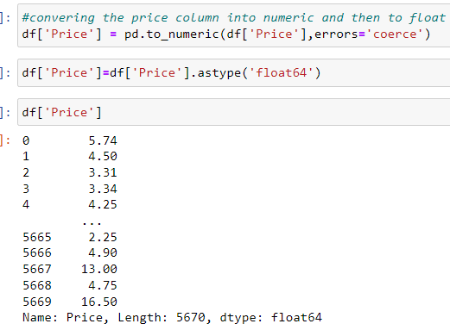
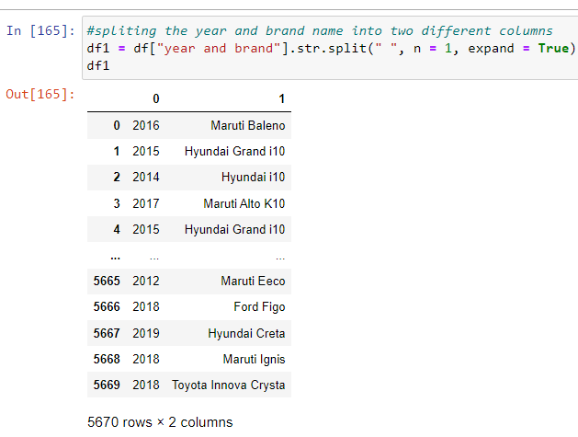
EDA AND VISAUALIZTION
Data contains object type data. We need to convert the object type data into numerical before model building.
Data contains some nan values which we will drop the column as the data loss is not more than 1%.
we will drop the columns unnamed and year and brand, unnamed is nothing but a serial number to the entry and we already split the year and brand into two differnt columns.

Slide 6
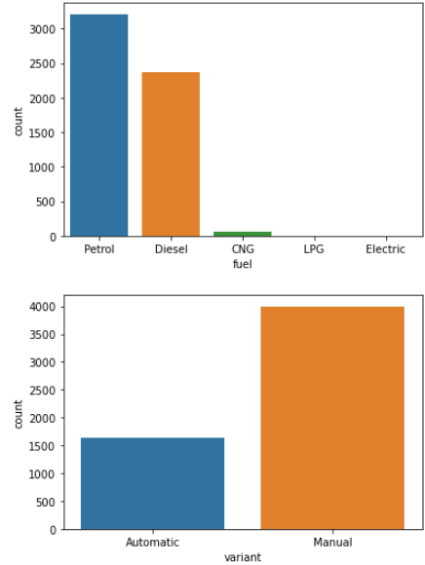
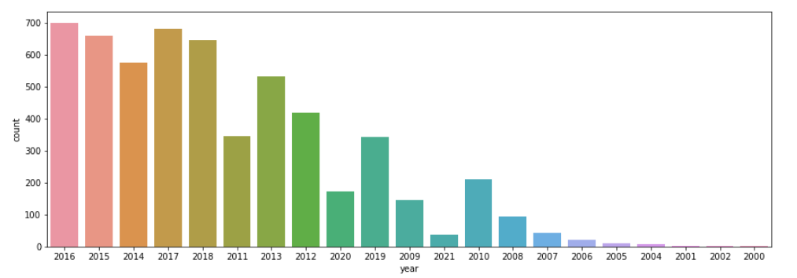
observations:
Most of the used cars are in petrol and then diesel. we can also see some of the cars with cng fuel, as the market is growing for electric vehicles we dont see a lot of electric cars being sold as used cars.
manual cars are what cost low when it comes to used cars and it is more likely to be sold in used cars compared to automatic.
most of the used cars for sale comes from the year 2016, 2017, 2018¶

Slide 7
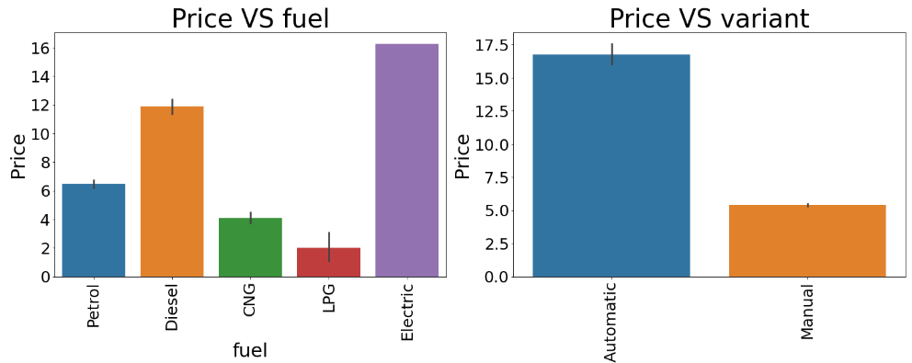
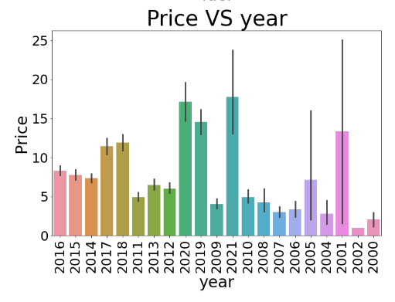
observation from the above graphs:
Whhat we saw from price vs fuel graph is that lpg used cars have the lowest price compared to all other cars as there are very less lpg pumps and demand for them is less
Price for diesel engine cars is more as diesel is less expensive than petrol and widely avialable
Price for petrol cars is moderate
Price for electric cars is the highest as they are newly introduced in the market and it cost very less compared to other fuels.

Slide 8
Price for electric cars is the highest as they are newly introduced in the market and it cost very less compared to other fuels.
Price for automatic cars is more compared to manual cars as automatic cars provide ease in driving and have high demand compared to manual cars.
When we checked price vs year graph we found that cars are expensive if the model year is from 2015-2021
Older the car, less is the price of the car an vica-versa.

Slide 9
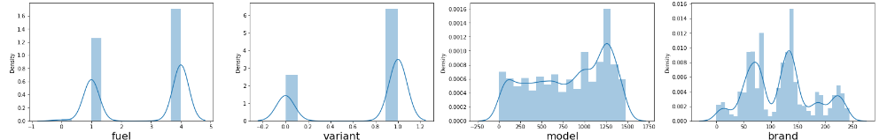
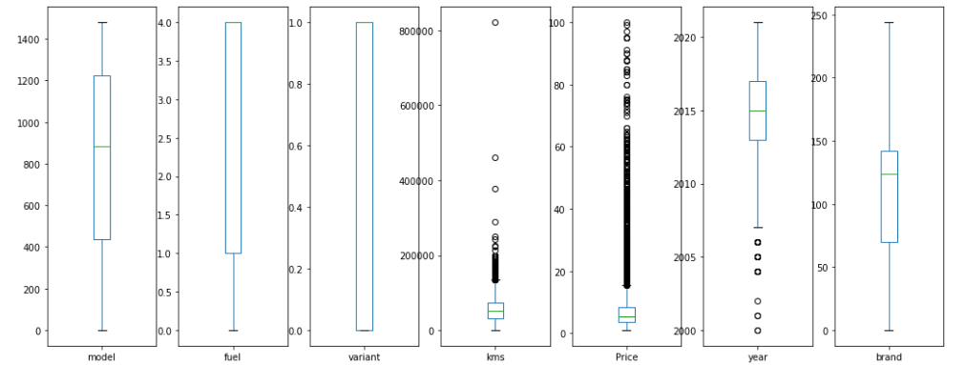
we can see biomodal distribution in the graphs.
we can see that there are some outliers present in the year column and kms column and we used zscore method to remove the outliers.

Slide 10
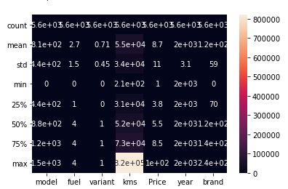
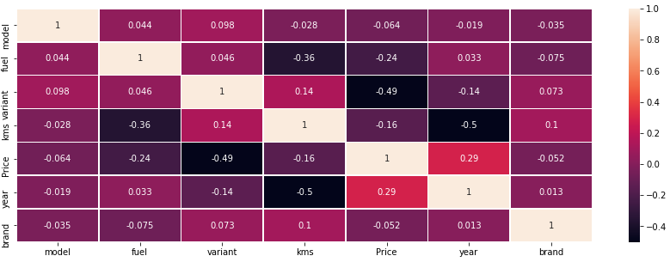
observation:
Brand and model columns are very less correlated to the price column.
variant year and fuel are very highly correlated to the price column and variant being the highest compared to the other two.¶

Slide 11
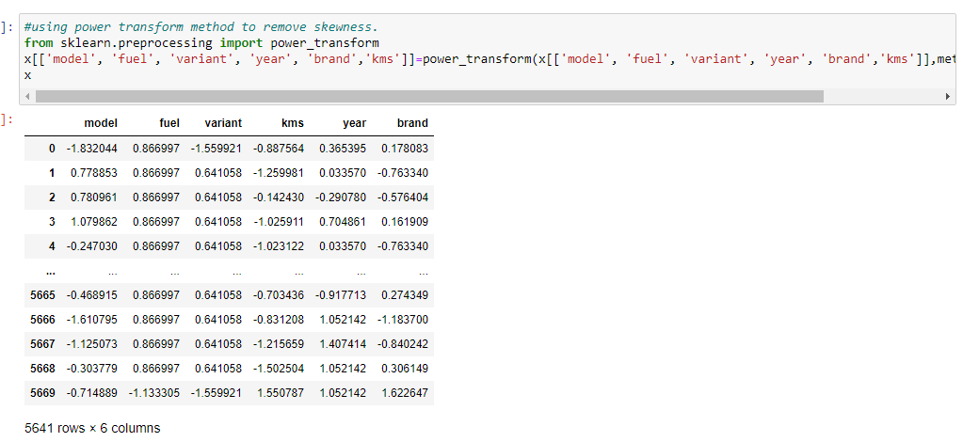
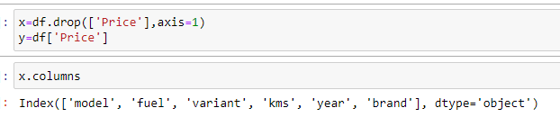
We saw some some skewness present in the data so we used power transform method to remove the skewness.
We used standard scaler to scale the data and feature scaling.
We split the data into x and y.

Slide 12
Model building & evaluation
We split the data into X & Y where x holds all the input variables and y holds the output variable.
We used standard scaler to scale the data and we went forward with model building of the data.
we will check the metrics such as r2_score and mean cross val score as well as mean absolute erroe before choosing the best model
We used regression models to predict the data like GradientBoostingRegressor, LinearRegression, Ridge, BayesianRidge, SGDRegressor, SVR, AdaBoostRegressor, KNeighborsRegressor, RandomForestRegressor, BaggingRegressor, DecisionTreeRegressor ,ExtraTreesRegressor.
Below are the images of the results that we got from our models and their r2 score, cross val mean score, as well as the error.

Slide 13
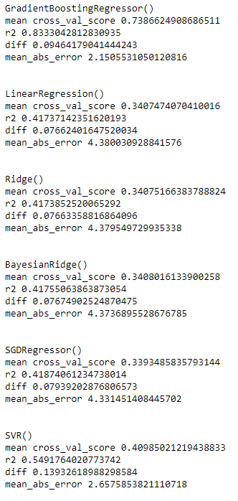
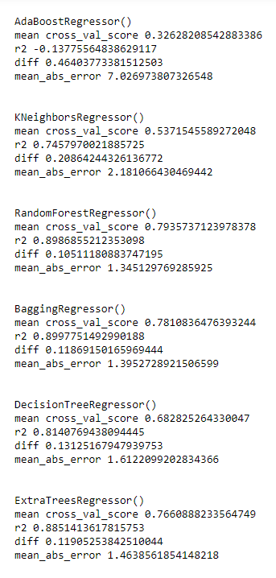

Slide 14
from the above results what we found is that our best performing models:
Bagging regressor is providing us with the accuracy of 89% and least cross val difference.
random forest is giving us the accuracy of 89% with less cross val difference
extratrees is giving us the accuracy of 88%
We will try to hyper tune our top 3 models and check whether we can improve the accuracy.
After hypertuning bagging regressor gave us the accuracy of 90%.
Below are the images of the results from hypertuning the models.

Slide 15
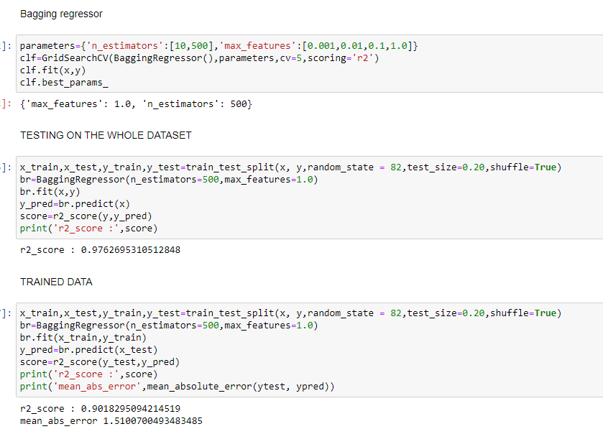
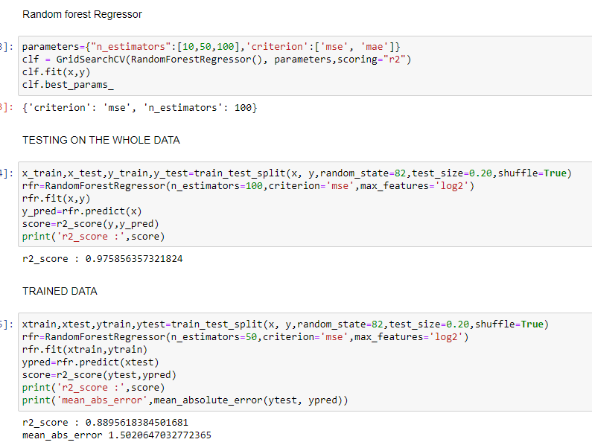

Slide 16
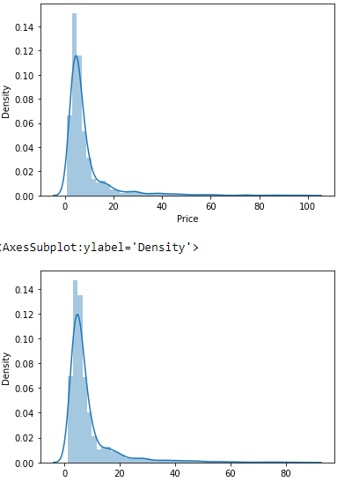
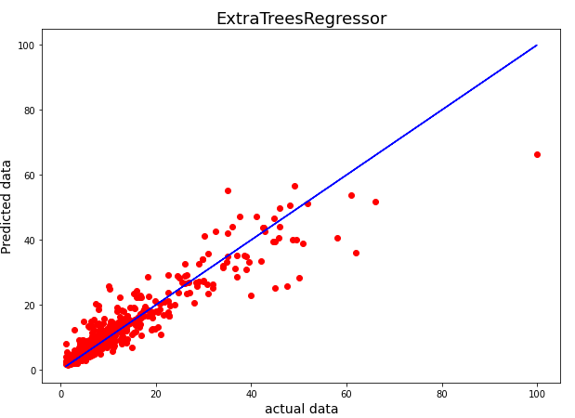
RESULTS
After hyper tuning we got close to 90% accuracy and with less error with Bagging regressor.
after hypertuning on Random forest we got the accuracy of 89%.
we found our best performing model with 89% accuracy which is ExtraTreeRegressor.
From the below images we can see that the actual data and the predicted data by our model very close to each other.

Slide 17
We saved the best performing model which is Bagging Regressor and used the model to predict the prices from the test data that we were provided.

Slide 18
conclusion
We were suppose to clean and analyse the data and used car prices.
We did some analysing cleansing of the data were able to perform some valuable analysis and we got the insights of features that we were affecting the price positively and negatively.
We were able to build a very good model with the accuracy of 91% which is quite good.
We saw in the graphs that the actual data and the predicted data provided by our model were very close to each other.
We predicted the results for the test data using our best perfoming model.
We can say that with more accurate data we can still improve the model with valuable features.

